Slide 1
Mastering LoadRunner 12.5
by Wilson Mar and Anil Mainali
May 1-2, 2016
at StarEast Orlando SeaWorld Renaissance Marriott

Slide 2
2-Day Agenda
Before
Sunday
Monday
After
1-Getting Started (Install LR,
Web Tours)
2-System Under Test
5-C API OAuth
6-TruClient
7-JavaScript
3-Analysis
4-Controller
Evaluations
Notes:
These are performance

Slide 3







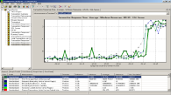
Overview
End User
Client(s)
Internet/WAN
Application Server(s)
Database
5
Virtualize Network
4
Virtualize Services
1
Author Scripts
6
Generate Load
7
Measure Impact
8
Analyze, Compare, Report
HP Live Network
Test Scenario
2
Collaborate
3
Plan and Execute Tests
Notes:
INTRO: HP designed the mobile performance testing process to integrate with what we have been doing.
Let’s review the process for those just joining us.
We emulate many real users by authoring scripts in (3) test scenarios.
(2) Version 11.52 of LoadRunner introduced the HP Live Network (HPLN) to enhance collaboration among LoadRunner users.
[line] If some web services are not available, we can use
(4) HP Service Virtualization software to mock those web services.
(5) And emulate network conditions during runs using HP Network Virtualization software.
We then (6) generate load so we can (7) measure impact using analysis tools in LoadRunner and Performance Center.
The scenario can be one vuser
NEXT: If you would like more information about LoadRunner, Virtual Networking, or Service Virtualization, scan these codes using your smartphone.
[ALT NEXT: We’re diving into step 1 – creating Scripts to generate load.
[ADDED: Groups, Animations, Larger fonts, switched HPLN text location, HPNV, HPSV]

Slide 4
Auto correlation
Create a Web (HTTP/HTML) script
Recording Options: JavaScript or C
Record just the Login
Close Correlation without activating
Run generated script (for errors)
Examine response HTTP headers
Activate Correlation found
Run script (for success)
Record next step
Activate next Correlation found

Slide 5
Stay in touch!
Social media
Twitter: #hploadrunner, @hploadrunner
Facebook.com/groups/HPLoadRunner for events
linkedin.com/groups?gid=1879289 (LoadRunner)
Linkedin.com/groups?gid=4539324 (TruClient)
HPLN.hp.com/group/performance-center-and-loadrunner
“Answers and code from those who really know”
hp.com/go/lrblog (LoadRunner Blog)
bit.ly/vLNibr (Discover Performance Blog)
http://h30499.www3.hp.com/t5/Discover-Performance-Blog/bg-p/discover-it-performance-management-blog
Notes:
We look forward to continuing this conversation with you on social media.
Listed here are what HP people maintain.
[ ] HP Software Support site link
Shlomi, you run a LinkedIn group just for TruClient?
Additionally, experts such as James Pulley are also active on Stack Overflow and other forums.
http://h30499.www3.hp.com/hpeb/attachments/hpeb/sws-APP_Perf_VaL_BP/2/1/HP%20LoadRunner%20v11%2000%20-%20Ajax%20TruClient%20Tips%20and%20Tricks.pdf
http://www.youtube.com/user/eLearning312/about

Slide 6
Script locations strategy
Windows File Explorer
VuGen
Doxygen
compare (diff)
My own GitHub .com or hosted
repo
clone
local git repo.
app default
VuGen Default
external archive
folder
folder
folder
push
manual copy
zip/ copy
files
files
files
files
Pull
request
Fork
Website Downloads folder
public
github.com repo
unzip
repo-master.zip
one-time
download
@Copyright Wilson Mar 2016
All rights reserved.
Notes:
This diagram describes the various locations script files can be moved and managed.
We will step through how to do each of these later, but first let’s review the basic strategy.
After a VuGen recording is saved in a folder, one can use Windows File Explorer to open that script within VuGen.
There are sample scripts that other people have made available from the public GitHub.com repository website.
After we download each repo into our Downloads folder and unzip it into a folder,
But rather than manually copy files, we think it’s more efficient to unzip folders directly into VuGen’s default folder,
We would likely will make edits to files, so
to recover from mistakes, for lack of anything better, we had been zipping copies of folders at various points into an external archival of snapshots.
This allows us to compare versions from different points in time.
When we want to make changes for ourselves in another person’s repository,
we can fork it into our own individual repository on github,
where we can clone it into our local git repository which we use as our app default folder in Program Files.
This gives us a more stable folder to run utilities such as Doxygen to create documentation.
Also, we won’t need whole copies in zip files because with github we push individual differences to our cloud repository.
We then request that the original repo owner to pull changes we made in our updated copy of the repo.

Slide 7
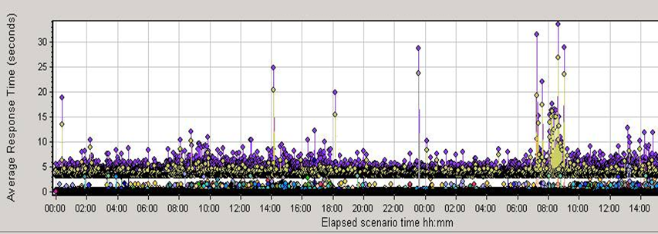
Single-user variability test results
Cloud Ops:
DBA:
Security:
Network:
Developer:
Security:
SysAdmin:
Scheduler:
VM Move
Log Shipping
Virus Check
Network
Reset
Full
GC
Tripwire Hashing
Full Backup
Report Job
Source: HP LoadRunner Analysis
Notes:
This chart shows a dot for each response time for the same request repeated over 48 hours, produced using HP LoadRunner.
Traditional teams typically don’t create this graph because they typically focus on averages, which filter out spikes shown here.
Since occasional delays impact only a few unlucky users, no attention is usually paid.
A Java developer may look at his own application log and see that one spike was caused by a full application Garbage Collection that stops the process briefly.
Occasional [network resets went unnoticed because the network team didn’t know about transaction response times and developers assumed the network just works.
But to resolve all spikes, often a [big meeting needs to be called to make individual assignments.
However, Agile teams do tend to ask for this because they have a sense of ownership for the entire picture.
And that makes all the different.
They seek to expose the root causes even though it’s someone else’s problem.
Agile teams tend to seek an integrated and comprehensive approach [across the organization because that’s what it takes to keep systems stable and controlled.
This is why Agile teams often assemble an integrated set of logs from all servers impacting a service.
Comprehensive investigations may reveal that a [big report job is scheduled to run while a [full backup occurs, and right in the middle of a TripWire job that calculates a hash of every file on the server.
After this was fixed, the total time for all jobs were cut by half.
This kind of analysis is crucial for user satisfaction now that users are spread across all time zones around the world.
When performance testers know the cost of [each process rather than being handed a black-box at the end of a Waterfall development phase, they won’t be just scratching their heads when, say, a DBA does [an experiment on the server without telling anyone else. And without convening a meeting, people would know what to do when a bad configuration change by [another team caused entire server instances to be moved to another physical machine automatically.
-------------
One of the most perplexing issues are occasional spikes in response time.
Our approach needs to be comprehensive because there are so many potential root causes for spikes large and small.
These spikes need to be controlled or at least explained so that stress test results are not “confounded” by random spikes.
This work involves meeting job schedulers of backups and batch reports, system admins configuring server settings (GC) and managing VM locations, network engineers (resetting), security (virus checks, and DBAs (log shipping).
The toughest part of this work isn’t so much the technology, but being able to find out who these people are. In large enterprises, some of them may not have ever talked to each other even though they may be a couple of doors away from each other.
Some issues like Full Garbage Collection within Java servers may have no owner because one person each considers it to be someone else’s problem.

Slide 8






Response to possible points of strain?
mDev:
Network:
Network:
Network:
Dev:
SysAdmin:
Back-end:
DBA:
Data Caching
Latency & Loss
Encrypt,
Compress.
Load Bal. Algorithm
Resource Usage
Server
Config.
Single Threading
DB Indexes
& Logs
Platforms & Versions
3rd Party
Cloud Services
2G,3G,4G Cellular
Firewalls
Web Servers
App Servers
DB Servers
Storage
Device Features
ISPs
Load Balancers
Screen Sizes
Carriers
Internet Browsers
VPNs
Web Services APIs
Monitoring
LANs
CDNs & CoLo.
Notes:
Before the internet, systems were built to run behind firewalls and through VPNs, perhaps even through private networks.
And scaling meant using load balancers distributing load among a fixed set of servers.
Mobile forced traffic through multiple public networks and cell carrier facilities shared with others, which can pose security nightmares.
To minimize changes and reach new capabilities faster, 3rd party cloud services are often added.
These developments occurred so quickly that few experts are available.
The need to add components to accommodate integration of mobile apps resulted in more frequent changes to systems. And instead of a mandated set of technologies, developers of public-facing apps now need to grapple simultaneously with several versions each on different platforms, device features on hundreds of new devices of various screen sizes displaying different internet browsers.
Organizations now need to absorb in their organizational silos not just new technologies but also new 3rd party cloud services such as Amazon, Google, and Apple for device and app store management, and tracking of hits, ads, crashes, etc.
For faster user response time Content Delivery Networks distribute files closer to users.
The new style of communication are lighter weight web services.
For scalability at much larger “web scale”, we are re-thinking the architecture of synthetic keys in SQL databases and toward storing incoming data like logs that are indexed later.
All this leaves us many choices.
NEXT: So how do we add value in this context? That’s the essence of a test strategy.

Slide 9
Strategies to avoid delay and strain
Data Caching
Latency & Loss
Encrypt,
Compress
Redirects
Resource # & Size
Auto- scaling
Server
Config.
No-SQL & Hadoop
Platforms & Versions
3rd Party
Cloud Services
2G,3G,4G Cellular
Firewalls
Web Servers
App Servers
DB Servers
Storage
Device Features
ISPs
Load Balancers
Screen Sizes
Carriers
Internet Browsers
VPNs
Web Services APIs
Monitoring
LANs
CDNs & CoLo.
Notes:
NOTE: NV can be applied to SV.
Mobile developers of course need to deal with the [_] fragmentation of mobile devices operating systems, features, screen sizes, and browsers.
But devs also need to work with [_] networking professionals to manage cellular, internet carriers, and internet server providers.
To reach new capabilities and users faster, many websites now use [_] 3rd party cloud services such as Facebook, Twitter, or Google for authentication and paid advertisments.
And use of [_] Content Delivery Networks such as Akamai or [_] distributed private networks means
the cost of [_] safe encryption and compression need to be measured and tracked.
To maintain the appearance of speed, many developers avoid [_] redirecting users to other servers and reduce
[_] the number of files and file sizes which take time to download.
It is expensive to jump through [_] firewalls, so developers [_] cache data locally on their users’ devices.
The more traffic, the more [_] load balancers need to distribute load among servers.
This is why more and more data centers avoid dedicating a fixed set of servers to
[_] particular servers and services.
[_] auto-scaling from among a pool of servers in a common cloud of machines.
We of course still need to squeeze more capacity from
[_] tuning server configurations and increase
[_] the efficiency of web services.
To accommodate massive input from end-users, mobile developers are using
[_] No-SQL databases which does not need to assign artificial keys to each input sequentially.
NEXT: How do we prioritize?

Slide 10
Time Budgets
1 second
200 – 400+ milliseconds
200 ms
100 ms
150 ms
50 ms
Platforms & Versions
3rd Party
Cloud Services
2G,3G,4G Cellular
Firewalls
Web Servers
App Servers
DB Servers
Storage
Device Features
ISPs
Load Balancers
Screen Sizes
Carriers
Internet Browsers
VPNs
Web Services APIs
Monitoring
LANs
CDNs & CoLo.
*Watch “Breaking the 1000ms second time to glass mobile barrier” at http://bit.ly/1mx7OHq
Notes:
Let’s break down the consumption of time.
If we can achieve a 1 second response time to users, [_] 50 milliseconds are used for storage processing.
[_] 150 ms by app server
[_] 100 ms to get out the door
[_] 200 ms to reach 3rd party services, and up to
[_] 450 ms, or a majority of the time traversing public networks.
NEXT: How do we quantify these times?

Slide 11
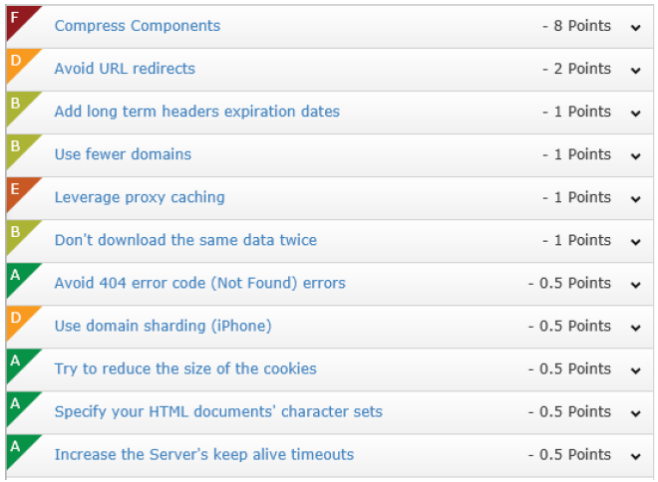


Recommendations to developers
stevesouders.com
Source: HP Network Virtualization 8.6
[P01]
Notes:
We don’t have time to go through all these.
The Shunra page has more calculations than
http://www.amazon.com/High-Performance-Web-Sites-Essential/dp/0596529309/ref=sr_1_14?ie=UTF8&qid=1368707130&sr=8-14&keywords=steve+javascript
http://www.amazon.com/dp/0596522304?tag=stevsoud-20&camp=213381&creative=390973&linkCode=as4&creativeASIN=0596522304&adid=09TZDJ7Z5GDMJPAM6XC6&

Slide 12
Timeline with Web Page Diagnostics
Previous Transaction
Start Transaction
ACK from server
End Transaction
Last byte received
Request sent
First byte sent
Last sync. file received
Think time
Page
fully rendered
(Network Delays)
Title visible
Time
Time to first buffer
(Network time)
HTML
DNS
Connection
Receive/ Server time
Client & Error time
SSL handshake
Transaction Time
Notes:
Think time is inserted before the transaction is started.
The Web Page Drilldown measurements revolve around when the ACK or Acknowledgement is received from the server.
That ACK is the first buffer received from the web server.
The DNS, Connection, and SSL handshake are all done by the operating system.
The first file is the HTML file, which contains commands to retrieve other files.
Modern browsers may display the Title even before the file is fully loaded.
When the last byte of each first file is received, that’s captured as the Receive/Server time.
During client time is when “below the fold” JavaScript runs.
LoadRunner ends a transaction when all files explicitly mentioned in the HTML file finish downloading.
That is not the same as the complete rendering of all frames called by JavaScript may occur asynchronously.
That may occur after the transaction is ended.

Slide 13



Different configurations during lifecycle
Development
Quality Assurance
Staging
Production
Application
Application
Application
Database
Application
Database
Middleware
Database
Middleware
Database
Middleware
Middleware
Local
Private
Traditional
Public
Why “it worked on my machine” but not elsewhere:
Provisioning and deployment processes are time-consuming
Manual processes are error-prone
Different people, tools, processes for each environment
Manual creation and hand-off of deployment docs and checklists
Notes:
Provisioning and deployment processes are time-consuming
Manual processes are error-prone.
Different people, tools, processes for each environment
Manual creation and hand-off of deployment docs and checklists
“it works on my machine”
Different credentials
Multi-dimentional
Multi-departmental
Multi-generational
Multi-faceted
Multi-ownership

Slide 14
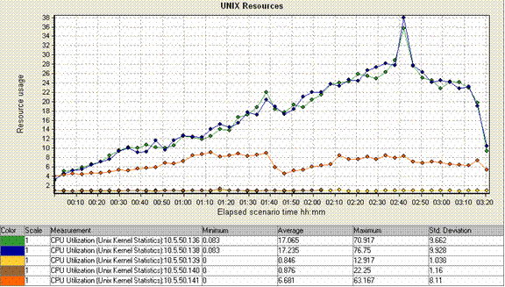
Co-existence Testing
Resource usage by server
Authentication server
App server
Notes:
When

Slide 15
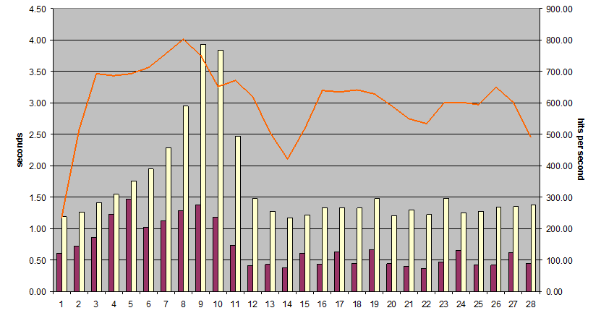
Response time & Hits per second
[P01]

Slide 16
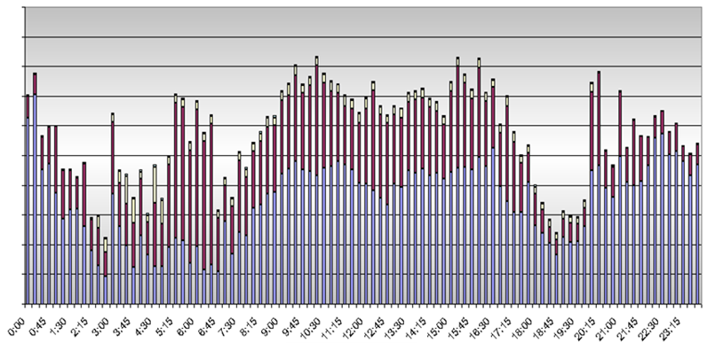
% Utilization
Head room
Peak

Slide 17
Measure exposure to performance risks
Server side
Risks | Exposure scenario
3. Pages load too many resources
3. Traverse through app iterations
Notes:
INTRO: In life we have risk of damage from fire, flooding, wind, earthquakes, etc.
When we buy a house we hire an inspector to assess how much exposure there is to possible risks.
With computer systems
1. Network slow
2. Spikes in network and server
3. Credential server spike capacity
4. Page loads too many resources
5. Server capacity
6. More hardware doesn’t increase capacity as much as expected
7. Size of Database affects speed
1. SpeedTest.net Global Library
2. Landing page repeat access
3. Sign-in-out stress test
4. Menu traversal through app
5. Random mix of transactions
6. Scalability tests
7. Different size test databases

Slide 18
Waterfall Chart
Redirects
Simultaneous Downloads
Uncombined files
Uncompressed files
https://developer.chrome.com/devtools/docs/network#resource-network-timing
Notes:
Most developers recognize the use of this waterfall chart.
NOTE: Add NV Analytics chart using
NOTE: NV Adds recommendations.
NOTE: HP’s software brings waterfall chart to not just HTTP traffic, but also mobile browsers or anything..

Slide 19
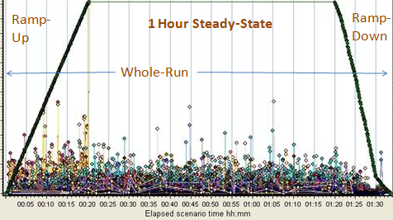
Bottleneck symptoms
Database connection pooling?
a) Slow first transaction
b) Bottleneck at low thread count
c) Many db. connections per user
d) High memory usage
e) High network usage
f) Response time spikes
g) Slow clean-up
recovery
Component pre-loaded?
Max. Threads Setting too low?
Single- threaded coding?
Too many & large files downloaded
Garbage Collection Memory?
Time-out settings
too long?
Notes:
Here are the most typical issues quantified by performance test runs.
a) If the first transaction of a run is slow, and the rest good, it usually is because components have not been loaded on the server or the client cache. To detect slow first transactions, I usually have a scenario group with a single VUser that starts before all the others.
Many LoadRunner users make the mistake of coding for first transactions over and over again rather than recording two iterations and using code from the second for all subsequent iterations.
It is useful to run load tests just doing login and logout repeatedly. Logins are usually the single most expensive transaction apps have. For office workers, does everyone jump on the system if they all arrive the same time every day? For mobile users, maybe when everyone gets off-work or when a plane lands?
b) Monitoring the number of threads each application process spins up during ramp-up can help to identify settings which limit how many threads can be spun up. Finding the most appropriate maximum threads settings is one of the possible outcomes of perf. testing. The default of only 5 on some software out-of-the-box was meant for development work, but is too low for production use.
c) If the number of database connections is monitored over time, seeing the same number of connections increase as the number of Vusers increase may be an indication of an issue with the app’s use of database connection pooling.
This is especially good to do during ramp-up because there may be a maximum to the number of connections allowed since each connection takes a certain amount of memory. Some data centers reconfigure their database server each night to shift memory from on-line connections to batch use.
d) When max. threads on application servers are set high, if bottlenecks still occur at a low number of threads anyway, it can be due to coding for thread pooling.
e) During the stead-state portion of a run, memory usage and response time should remain constant, unless there is a problem with automated memory management. The flat line in Vusers should not represent the same Vusers, but two groups: a certain percentage of Vusers who drop off while another group adds new users over time.
e) It’s difficult to identify high network usage unless loads are emulated by LoadRunner. But we can measure what each transaction requires in terms of number of files and the size of each file. Mimification to remove white space ignored by programs help. To improve performance, some mobile developers now put JavaScript and CSS code in-line to minimize the number of files downloaded.
f) We know that full garbage collection in Java causes random spikes in response time. Some find it helpful to run longevity load tests to see if incremental garbage collection can manage over several days, to see if server operators have to hassle with bringing servers on and off line just to reset memory.
g) If you find that during ramp-down, memory does not get freed up in proportion to Vusers leaving, then you have a slow clean-up recovery problem. When time-out settings are too long, sessions remain in memory longer than they should. On the other hand, when time-outs are set too quickly, users find it annoying to lose sessions. So finding a balance is another good reason for doing load testing.

Slide 20
Possible internal bottlenecks
Component pre-loaded?
Max. Threads Setting too low?
Database connection pooling?
Single- threaded coding?
Too many & large files downloaded
Garbage Collection Memory?
Time-out settings
too long?

Slide 21
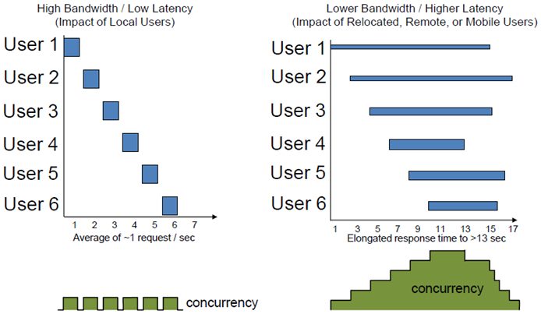
Concurrency and rendezvous
[P10]
Notes:
NOTE: Memory impact ???
Residency of vusers in memory ???
“Islands” of network requests

Slide 22
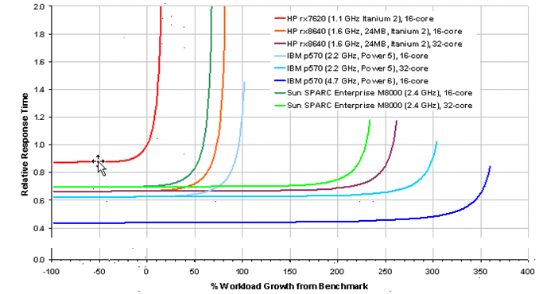
Scalability swapping out to another server
http://wwwperftest.com
[P01]
Notes:
This is a graph of how various servers.
The dot is the “elbow” of when response time is impacted.
What does this chart tell us?

Slide 23
Capacity story in multiple dimensions
Capacity:
# Vusers (imposed load)
% CPU utilization, Memory
Memory per user
# Seconds response time
Transaction per second rate
Waiting for others
Load level
Light load
Heavy load
Overload
Notes:
In this more stylized diagram, we have an increasing number of scripted vUsers imposing load at the same time.
Starting from a [_] light load, we ramp up load until the [_] Transactions per second and other processing rates peak before dropping off with increasing load.
We know that we’ve reached the point of
[_] capacity, when heavy load becomes overload as additional load is imposed.
[_] Response times begin to increase due to transactions [_] waiting for others to finish.
Usually this is also the point where [_] resources such as CPU and memory becomes fully used.

Slide 24
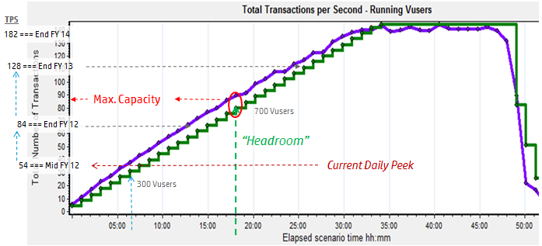
Projections (example)
[P01]

Slide 25
Capacity
Upgraded Capacity
Point of
failure
Anticipated Peak Loads
Existing Usable Capacity
Head room
Response Time degradation
noticeable
Work
load
Current
load
Trigger
Point
Lead Time
Time
Source: http://wilsonmar.com/perftest.htm
Notes:
This graph is based on the daily peak work load achieved [_] over time [_] obtained from monitoring of actuals in production, then [_] fitted with a trend line that [_] approximates the current load, even though it is usually NOT linear. [_} Performance emulation tests run to the point when users began noticing slow response time [_] predict the existing usable capacity. Additional load [_] addition added to the point of failure, when even queues become full, is irrelevant.
[_] “head room” is the difference between the current actual demand and usable capacity. This reserve capacity to absorb sudden growth in demand will run out if there is growth. When marketing projections are translated to an estimate of [_] anticipated peak loads, from capacity planners can define how many additional resources are needed to achieve the [_] Upgraded Capacity needed.
Upgrades to capacity can be smoother if there is what the ITIL methodology calls a common Forward Schedule of Changes (FSC).
To identify when equipment upgrades will actually be available, we need to calculate [_] Lead time for planning, ordering, and testing.
The [_] beginning of that lead time is the trigger point when purchase orders need to be cut.
Thus, this chart gives actionable meaning to production monitoring.
NEXT: Workload Model

Slide 26
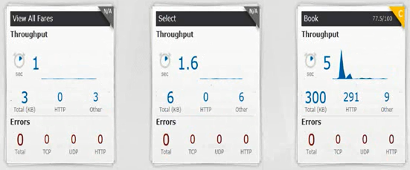
Track transactions with network impact
Notes:
From select transaction that transmits [1:05:27].

Slide 27
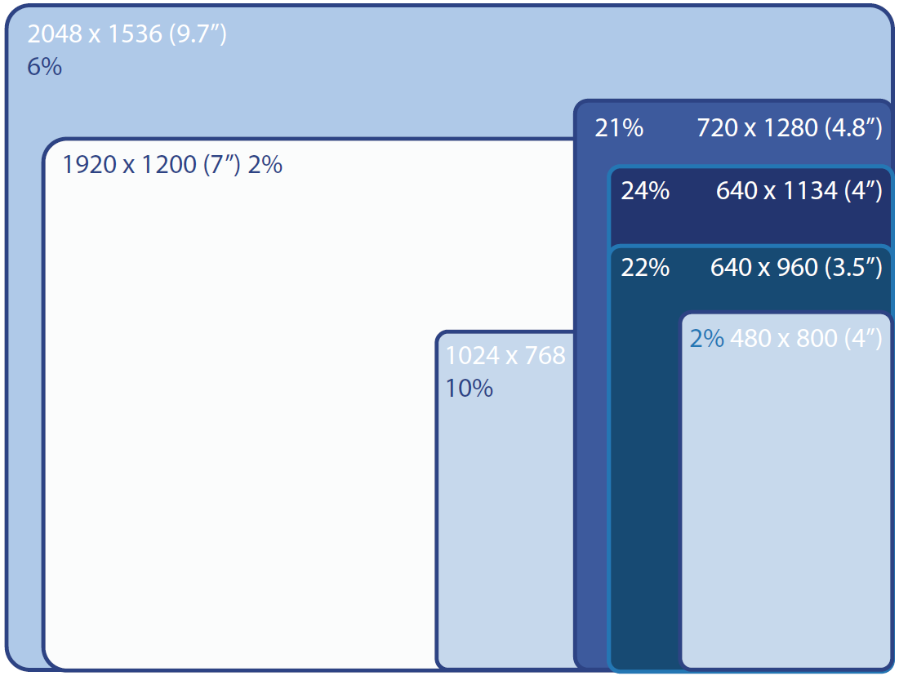
Mobile screens density growing beyond Full HD
1900 x 1080 = Full HD TV
7600 x 4320 = 4X HD TV
http://www.perfectomobile.com/content/mobilecloud-device-statistics
Notes:
Last Christmas I got a full HD television and laptop screens.
But HD resolution is less dense than some mobile devices.
[] The 2048 x 1536 pixels on the 9.7 inch Apple iPad mini Retina display.
BTW, this resolution is also the 3 Megapixel resolution needed for high quality printing of 8 x 10 inch standard frames.
Since the larger the screen, the more pixels are generated.
On the other extreme, we look for graphic files that are excessively large for smaller screens, especially in responsive sites which download the same image file on all screen sizes.
Some sites use back-end jobs to generate different size files automatically.
This is why SVG (Scaled Vector Graphics) is gaining popularity, now that HTML5 supports it.

Slide 28
Measure exposure to performance risks
Server side
Risks | Exposure scenario
1. Network impact
SpeedTest.net to Global Library
2. Spikes in network and server
2. Landing page repeat access
3. Pages load too many resources
3. Traverse through app iterations
4. Server spike capacity bottlenecks
4. Stress tests from log-in
5. Internal contention
5. Rendezvous mix of transactions
6. More hardware doesn’t increase capacity as much as expected
6. Scalability up and out
7. Servers underutilized
7. Different configurations, database sizes
Notes:
We’ve be covering the rest of the risk exposures in our next webinar, where we cover performance engineering in more depth.

Slide 29
Mock Test
Try
http://guru99.com/component/com_bfquiz_plus/Itemid,200/catid,33/view,onepage/
Notes:
These are performance

Slide 30
Performance Testing Questions

Slide 31
Question 123
Executable programs in LoadRunner version 12.2 are:
A. 16-bit
B. 32-bit
C. 64-bit
D. 128-bit
Notes:
Being a 32

Slide 32
Question 124
An ISO Reader is needed to install:
A. Community Edition exe files.
B. Licensed LoadRunner downloads
C. VTS (Virtual Table Service)
D. Microsoft Office (Excel, etc.)
Notes:
Answer: B

Slide 33
Question 125
What is your download bandwidth?
A. 1 kb/Sec.
B. 10 kb/Sec.
C. 100 kb/Sec.
D. 1000 kb/Sec.
Notes:
100+

